Slide 1
MFA Recovery & Lockout Communication Guide
The document outlines recommended steps for users who face account access issues because of lost or inaccessible Multi-Factor Authentication (MFA) devices. It also provides guidance on secure recovery methods and shares best practices to reduce the risk of future problems.

Slide 2
The Objective of Multi-Factor Authentication (MFA)
Multi-Factor Authentication (MFA) is a robust security protocol designed to strengthen account protection by requiring users to authenticate their identity through multiple methods, such as a password and a code from a mobile application. This approach is crucial in safeguarding against unauthorized access, even in scenarios where a password may be compromised.
2. Recovery Process (Lost or Inaccessible Device)
In the event of losing access to your Multi-Factor Authentication (MFA) device, please adhere to the following protocol:
  Promptly inform the IT Support team of the situation.
  Confirm your identity using a secondary email or by answering security questions.
  An IT Administrator will facilitate the reset of your MFA registration.
  Proceed to re-register your MFA on a new device utilizing Google Authenticator or another sanctioned method.
Conduct a login test to verify that the MFA setup is operating as expected.

Slide 3
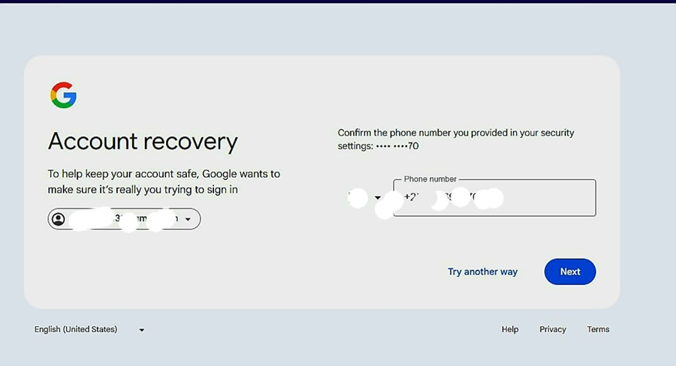
Captured Visuals.

Slide 4
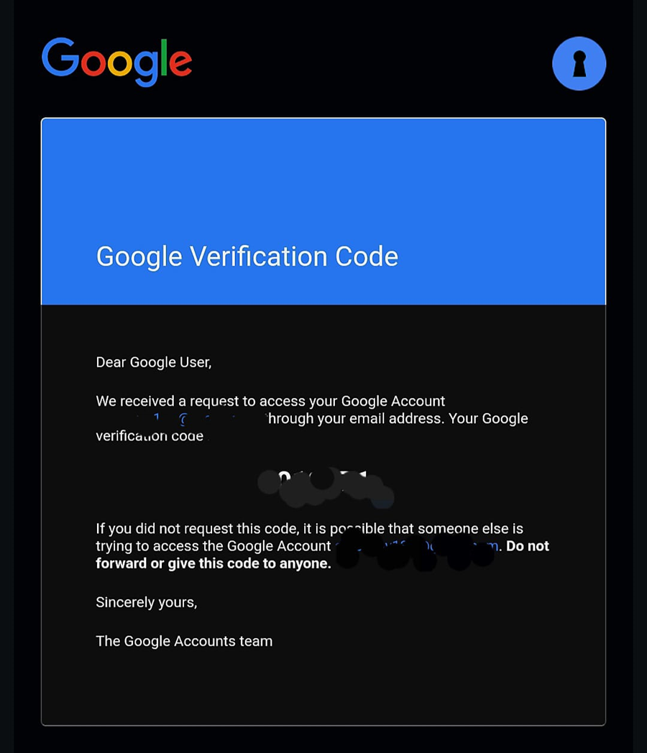

Slide 5
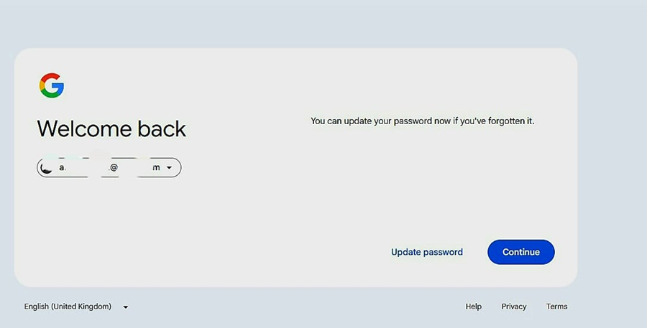

Slide 6
Proactive Strategic Recommendations
Ensure you only approve MFA prompts that you have personally initiated.
  Consider implementing an additional sign-in method, such as SMS or a recovery email, for enhanced security.
  Regularly review and update your multi-factor authentication (MFA) settings on a quarterly basis.

Slide 7
5. Support Contact
If you encounter any difficulties completing the recovery process, please reach out to your system administrator or IT support desk for assistance.
For support, you may email our IT Support at:
Alternatively, you can call our help desk at your convenience.

